Slide 1



JavaScript vs TypeScript
What's the difference?
And also a market perspective
Robert Le

Slide 2
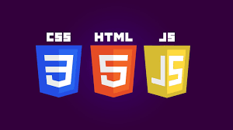

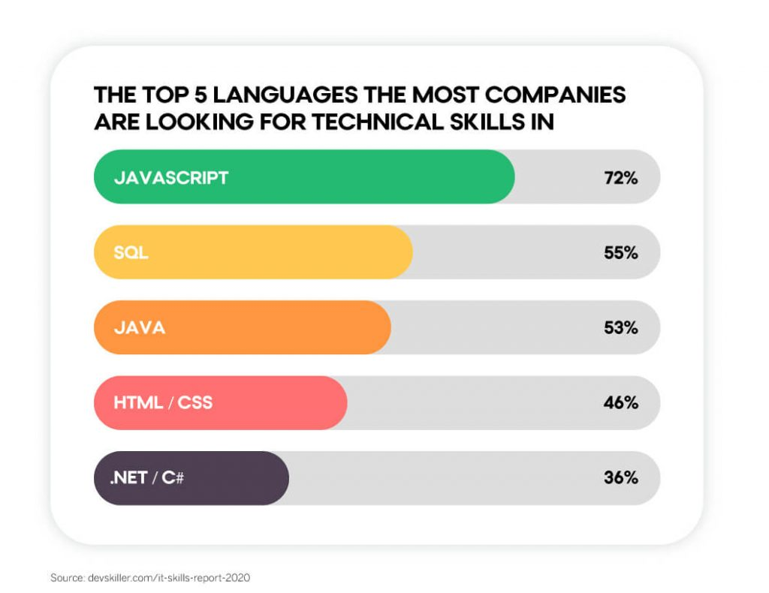

JavaScript, the fan favorite
The infamous “learn HTML, CSS, and JS” to get a high paying job
One of the staples for web development/full stack, a field always in demand
Versatile and industry standard frameworks, such as Vue.js, Express.js, React.js
Constant support, such as with Node.js

Slide 3
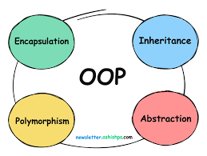
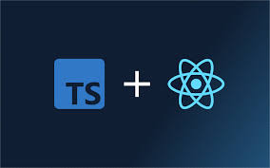
So what’s TypeScript?
A relatively new language by Microsoft, coming out in 2012
Addressed the shortcomings of JS, such as static typing
A compiled language, unlike JS, an interpreted language
Basically the “stricter JS” with better development tools and error checking
Includes interfaces, classes, inheritance, polymorphism
“The C++ of JavaScript”
Notes:
Slide: "So what’s TypeScript?"
First bullet (TypeScript's release in 2012):
TypeScript was created by Microsoft in 2012. It’s been around for a little more than a decade, gaining popularity as JavaScript projects and codebases grew in size and complexity.
Second bullet (Shortcomings of JavaScript):
JavaScript is a dynamically typed language. This flexibility makes it easy to write code, but difficult to maintain and scale in larger projects.
One major shortcoming is the lack of static typing—you don’t know if you’ve made a typo or a wrong data type assignment until runtime. TypeScript adds static typing, allowing you to catch errors earlier, while you're coding.
Tooling support in vanilla JavaScript isn't as robust for large projects. In JS, you may need to rely on linters and external tools to enforce code quality. TypeScript offers built-in error detection, better autocompletion, and navigation features.
Lack of interfaces and clear object structures: In JavaScript, object shapes are flexible, which can cause bugs if someone mistakenly uses an object in the wrong way. TypeScript enforces strict type-checking on object properties.
Third bullet (Compiled language):
Unlike JavaScript, which is interpreted directly by browsers, TypeScript needs to be compiled into JavaScript. This compilation process catches many errors before the code is run, saving debugging time.
Fourth bullet (TypeScript as "stricter JS"):
TypeScript offers a "strict mode" that makes JavaScript development safer and easier to maintain. It helps avoid issues like undefined variables or type mismatches by enforcing rules at compile time. Essentially, TypeScript is like JavaScript with more rules, making it a better choice for larger projects with complex logic.

Slide 4
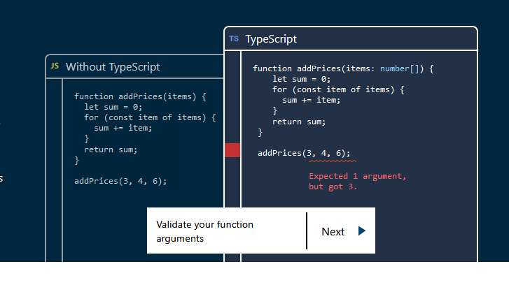

Slide 5
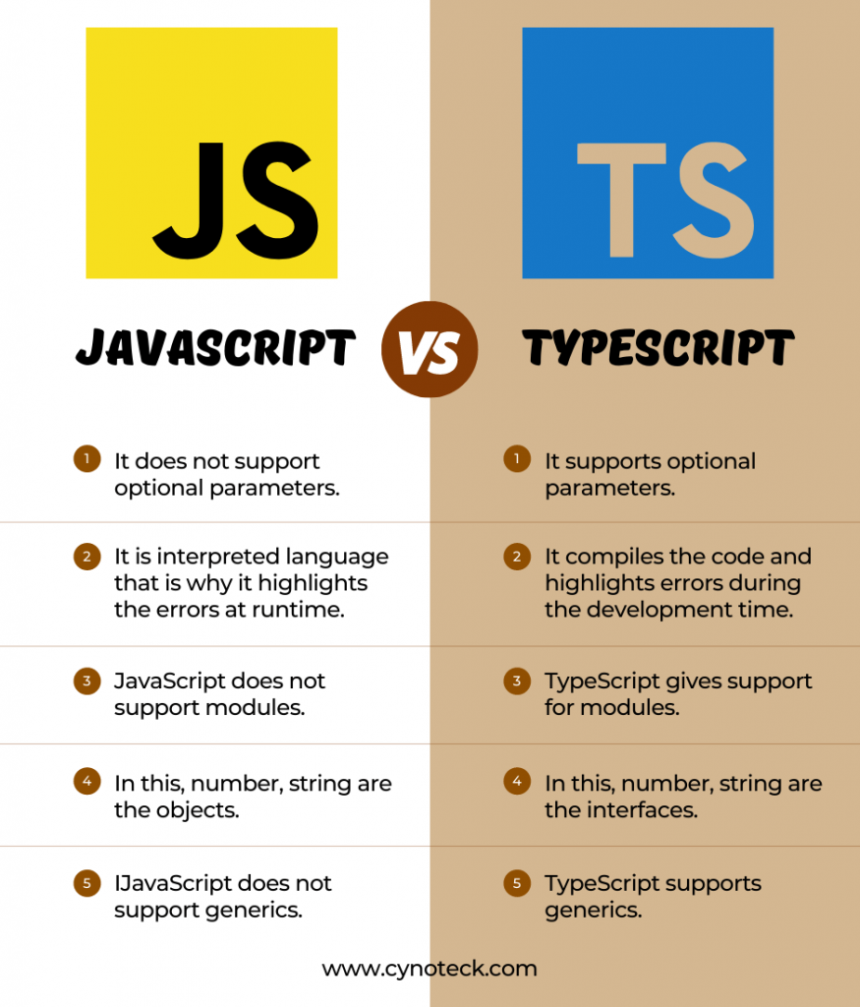

Slide 6
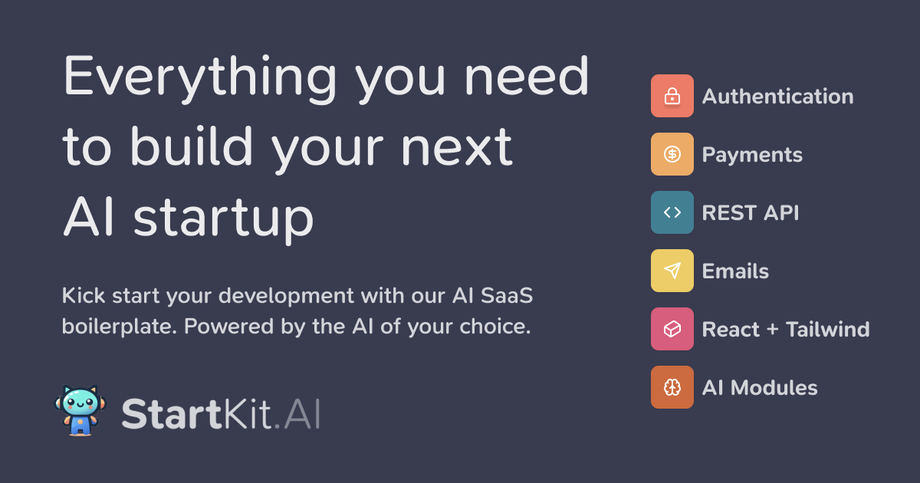
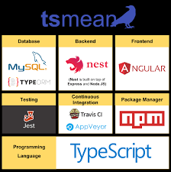
So what’s the point of TypeScript?
Many startups, especially the “AI hype” startups use it
Becoming an industry standard, especially among small/new companies
Has the same capabilities as JS such as full stack/web development
Most developers prefer it over JS, according to a StackOverflow survey
Reliable and great for large projects
Sounds cooler

Slide 7
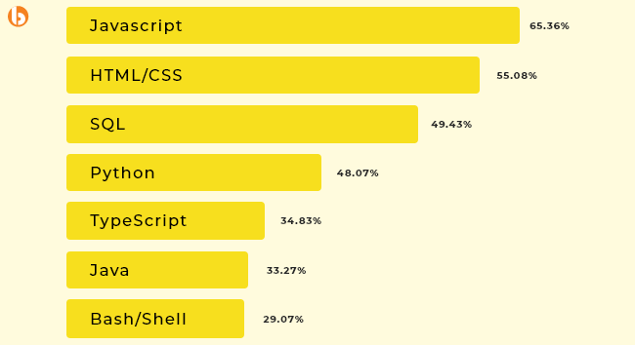

Slide 8
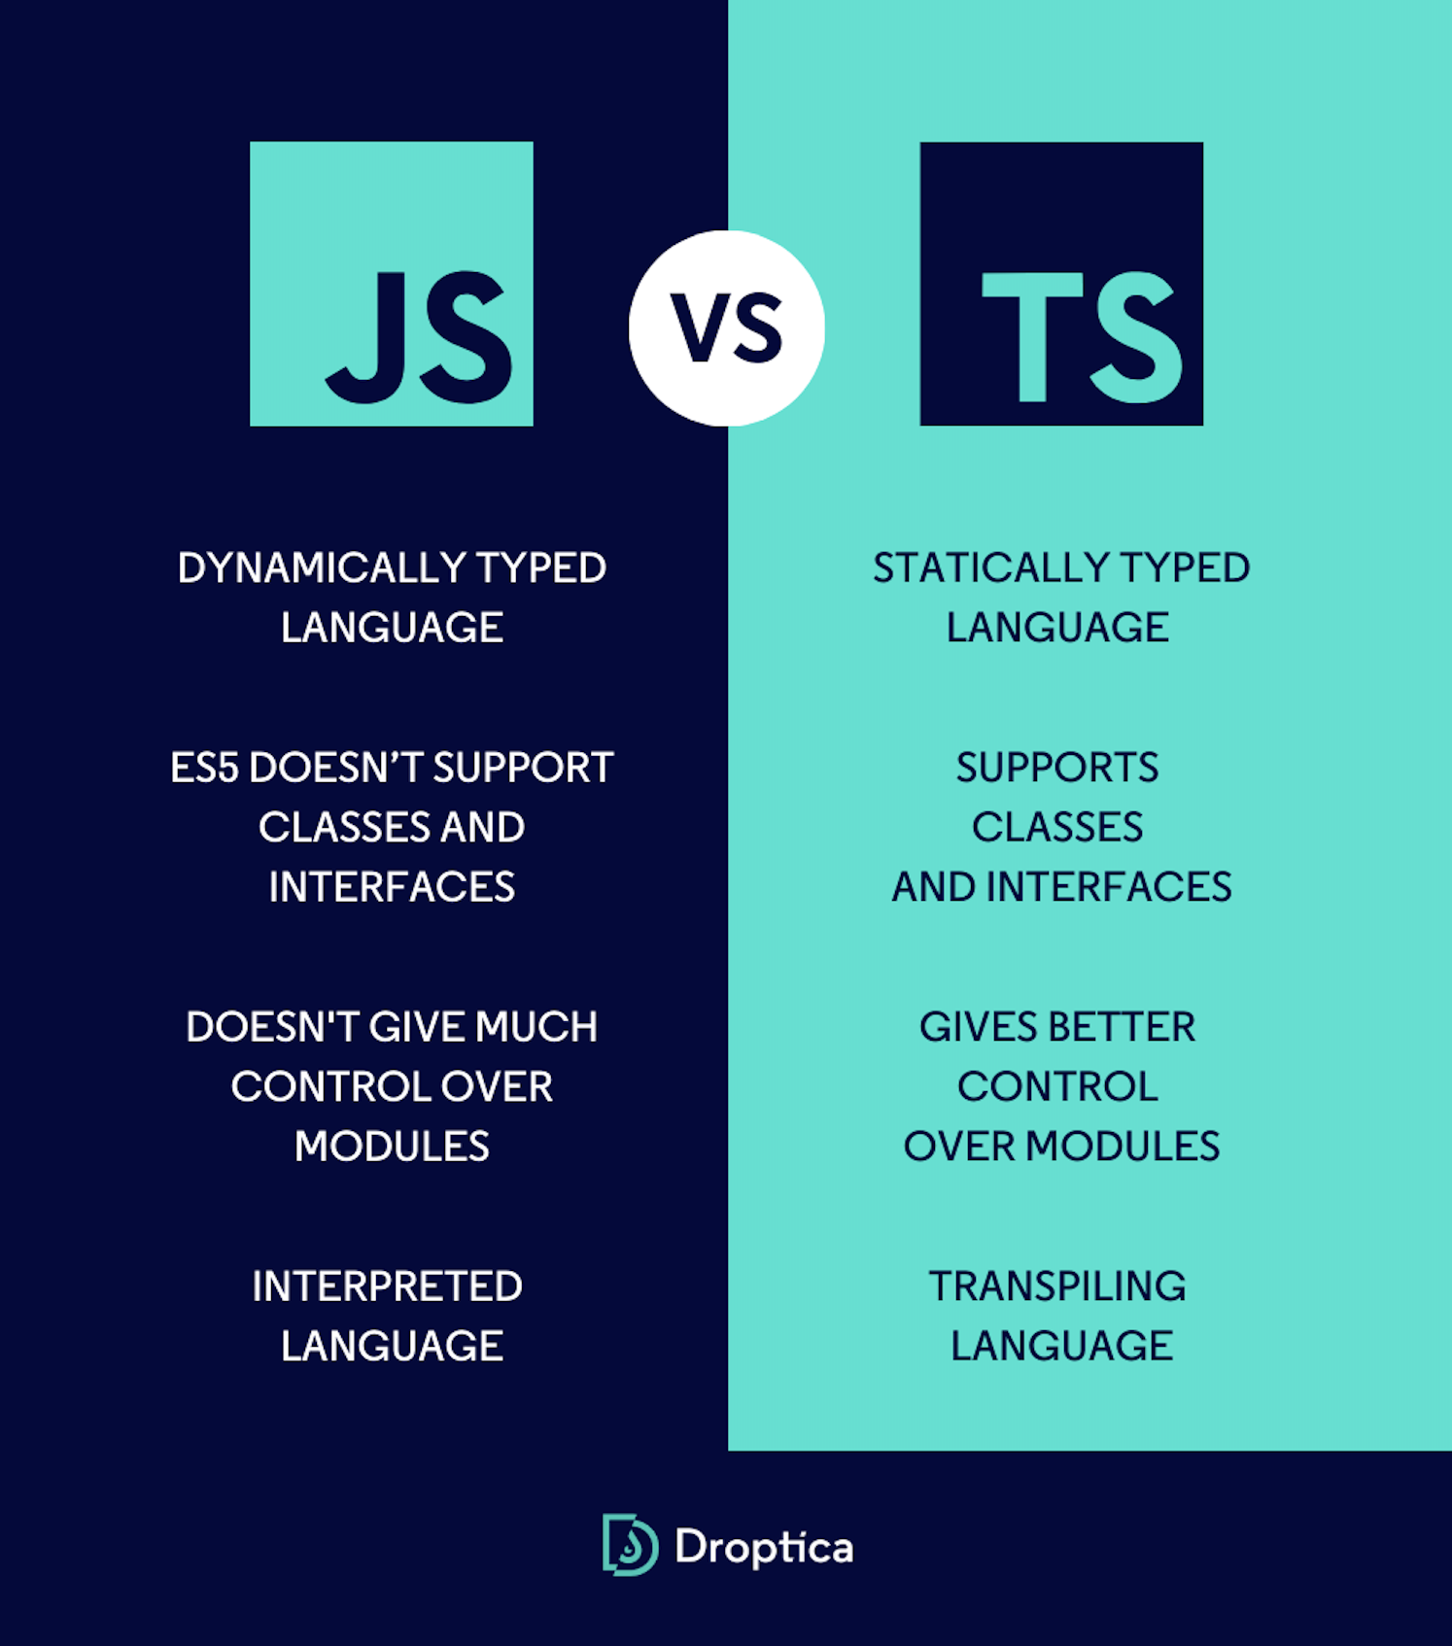
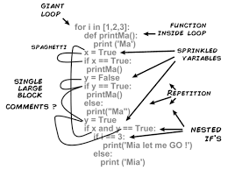

So is TS faster than JS?
The answer may surprise you, but in the production/run-time sense, no
The benefits of TS weigh in a software development and code readability sense

Slide 9
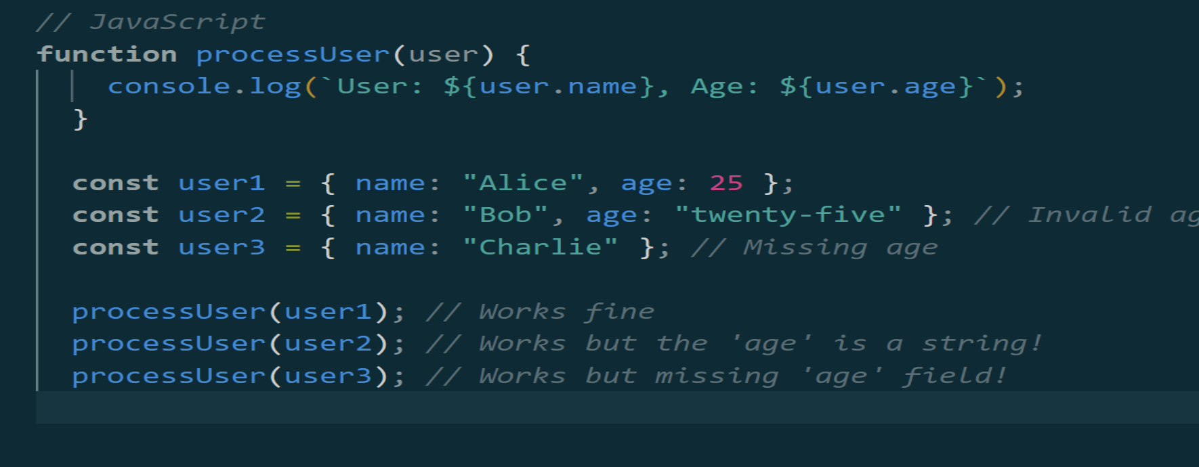
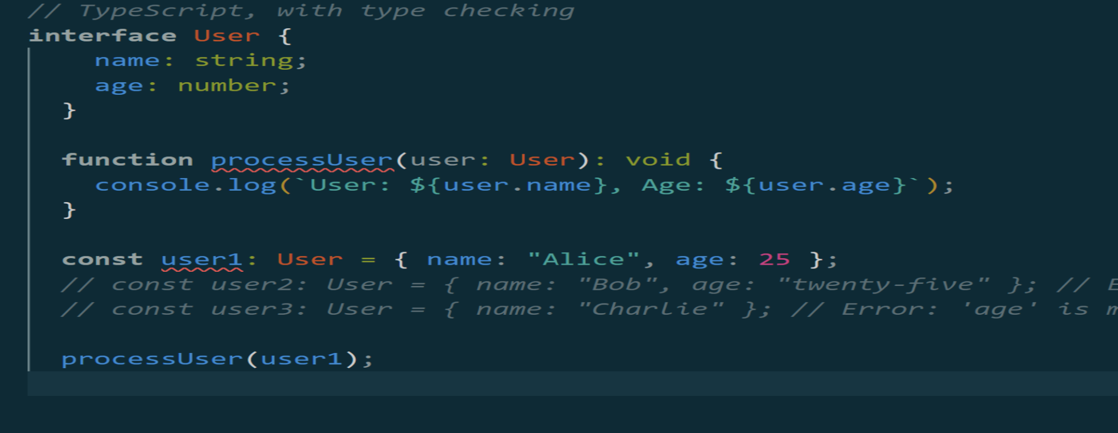
Code side by side

Slide 10

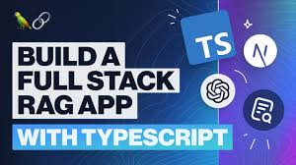
Diving deep on the AI startups and TypeScript…
They love TS because it’s cool
But the scalability and support for libraries, for example AI libraries such as TensorFlow, Hugging Face, LangChain
Code readability among vast engineers of different fields
Enhanced bug catching since AI is a complicated software
Fast production and code quality

Slide 11
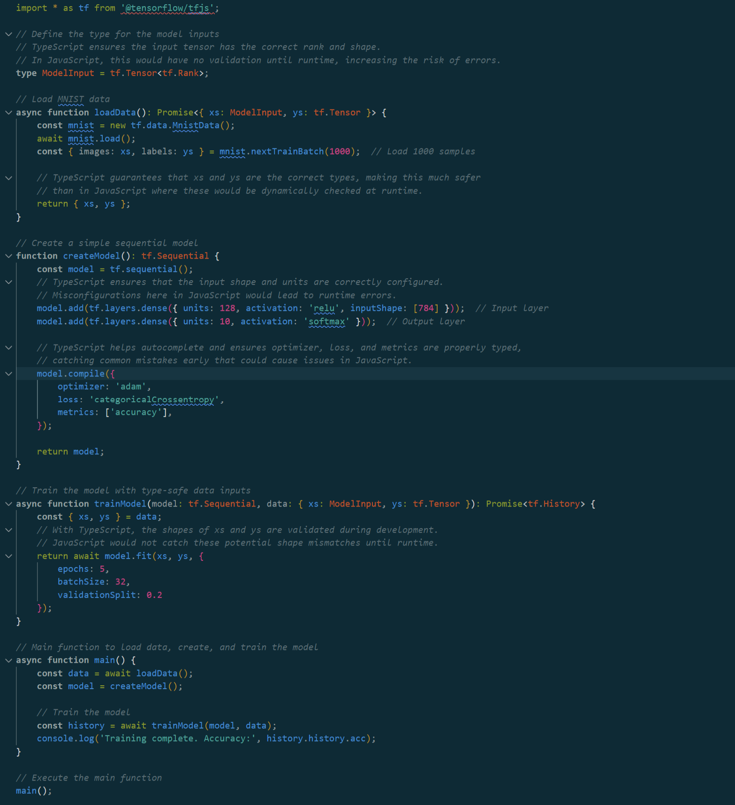

Slide 12
Live Demo - 2 to-do apps with JS and TS t o -do apps
Code:
https://github.com/Hackerdude374/csc-490-JS-vs-TS
Video:
https://drive.google.com/file/d/1PAfkv3w5gVVpoGyAz8gnNA16mutUzYtv/view?usp=drive_link

Slide 13
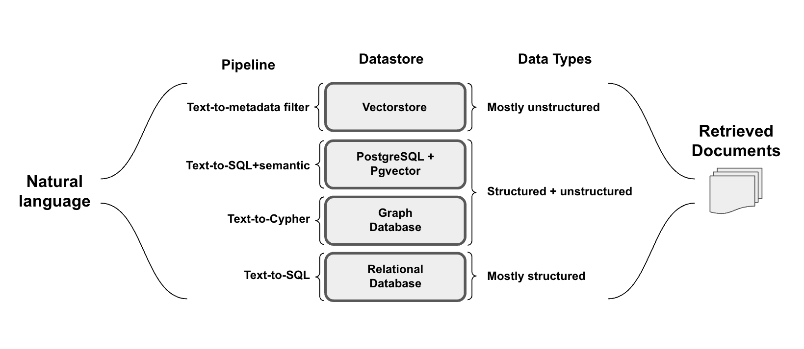
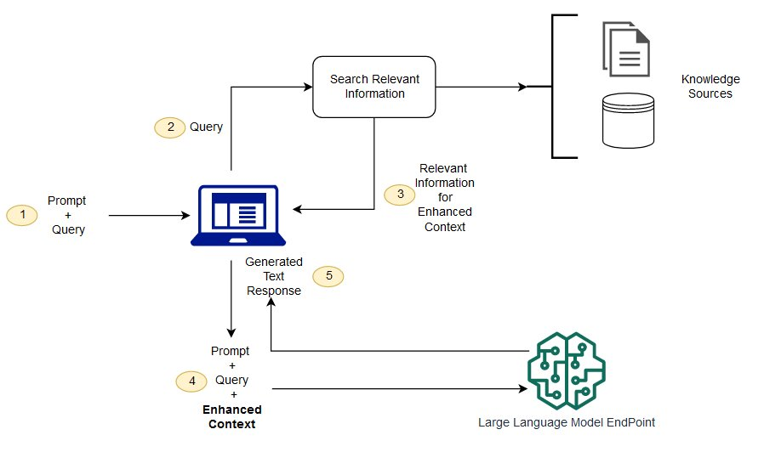
Job market: Is it worth it to learn JS/TS?
In today’s market, you have to showcase outside learning and a drive/”passion” for SWE more than the average student
JS is the forefront of web development and a staple of the industry
TS is growing and also has a huge need in the industry
Suggestions is to learn both, learn full stack development with both languages using online resources such as Udemy, Youtube, documentation
Maybe learn how to implement AI functionalities such as LangChain in your apps - build RAG (Retrieval Augmented Generation) projects
My data engineering/web dev internship is currently implementing TS for future projects

Slide 14

Thank you!

